Slide 1




GASPI Tutorial
Christian Simmendinger
Mirko Rahn
Daniel Grünewald
Sponsored by the European Commission through

Slide 2
Schedule
9:00h begin
10:15h-10:30h break
11:45h-12:00h break
13:00h-14:00h lunch
15:15h-15:30h break
17:00 end

Slide 3

GASPI Tutorial Questionnaire
https://www.surveymonkey.co.uk/r/RPH2333
INTERTWinE - Programming Model INTERoperability ToWards Exascale

Slide 4
Installation
Tutorial code and documentation: git clone https://github.com/GASPI-Forum/GASPI-Standard.git
GPI-2 - GASPI Implementation: git clone https://github.com/cc-hpc-itwm/GPI-2.git
install.sh –p $HOME/GPI-2.foo native GASPI version, start application with gaspi_run
install.sh –p $HOME/GPI-2.bar –with-mpi=MPI_ROOT mpi interoperable version, start application with mpirun

Slide 5
Round of Introductions
Who are you?
What are you doing?
How did you get in contact with GASPI?
What is your interest in / expectation to GASPI?

Slide 6
Goals
Get an overview over GASPI
Learn how to
Compile a GASPI program
Execute a GASPI program
Get used to the GASPI programming model
one-sided communication
weak synchronization
asynchronous patterns / dataflow implementations

Slide 7
Outline
Introduction to GASPI
GASPI API
Execution model
Memory segments
One-sided communication
Collectives
Passive communication

Slide 8
Outline
GASPI programming model
Dataflow model
Fault tolerance
www.gaspi.de
www.gpi-site.com

Slide 9
Introduction to GASPI

Slide 10
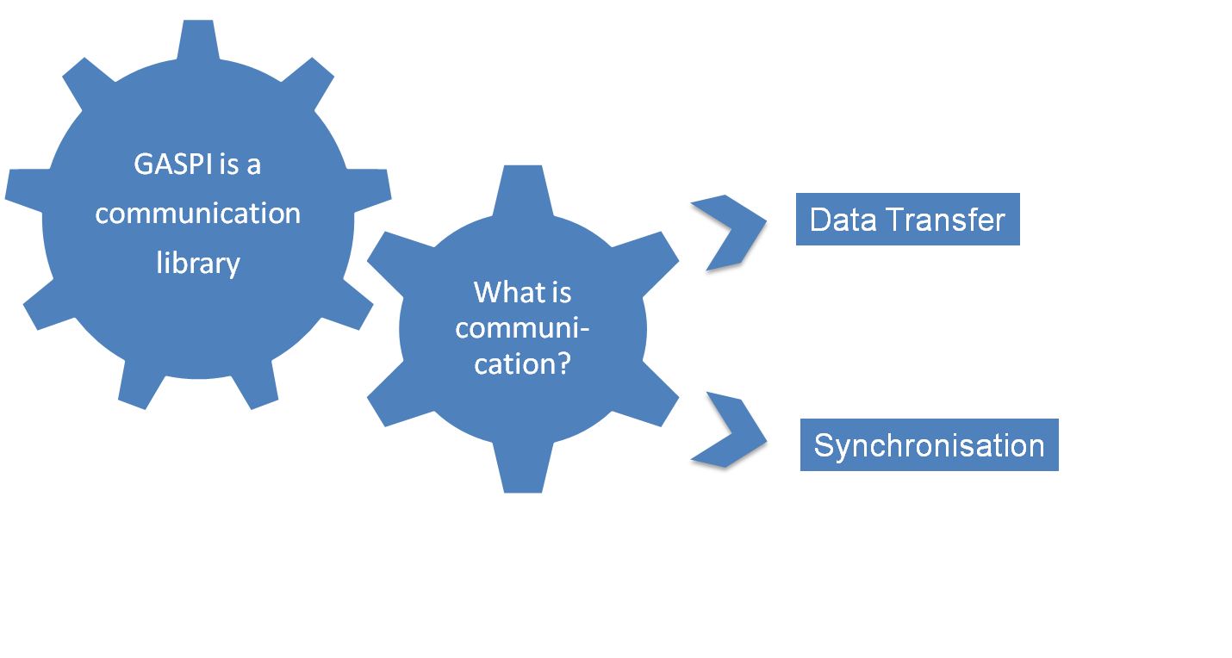

GASPI at a Glance
Nuts and Bolts for Communication Engines

Slide 11
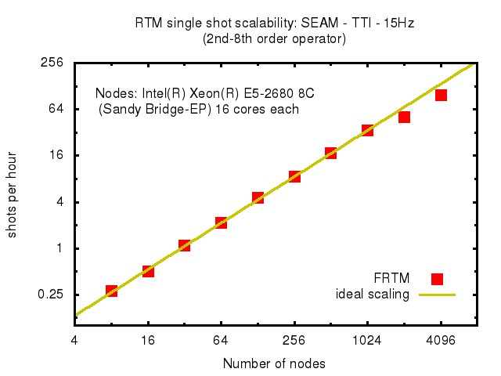
GASPI at a Glance
Features:
Global partitioned address space
Asynchronous, one-sided communication
Threadsave, every thread can communicate
Supports fault tolerance
Open Source
Standardized API (GASPI)
tested on up
to 65k cores!
Infiniband, Cray, Ethernet, GPUs, Intel Xeon Phi, Open Source (GPL) , standardized API

Slide 12

GASPI History
GPI is the implementation of the GASPI standard
originally called Fraunhofer Virtual Machine (FVM)
developed since 2005
used in many of the industry projects at CC-HPC of Fraunhofer ITWM
Winner of the „Joseph von Fraunhofer Preis 2013“
Finalist of the „European Innovation Radar 2016“.
www.gpi-site.com

Slide 13

GASPI
Standardization Forum
Founding Members

Slide 14
GASPI in European Exascale Projects

Slide 15
Some GASPI Applications
Visualization
CFD
Machine Learning
Big Data
Iterative Solvers
Seismic Imaging & Algorithms

Slide 16
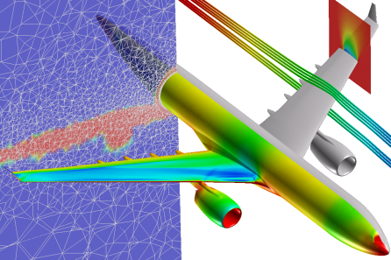
Concepts: Communication
GASPI is a
communication
library
What is communi-cation?
Data Transfer
Synchronisation

Slide 17
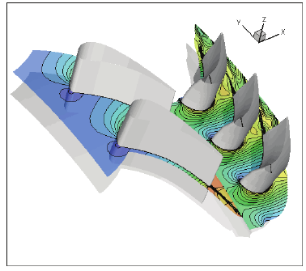
Concepts: One-Sided Communication
One-sided operations between parallel processes include remote reads and writes
Data can be accessed without participation of the remote site
The initiator specifies all parameters
Source location
Target location
Message size

Slide 18
Concepts: Segments
Data can be accessed without participation of the remote site.
Remote sides have to know about designated communi-cation area(s) before hand
Designated communication areas in GASPI are called segments
Node 1
Node 2
Segment 1
Segment 1
Segment 2
Segment 2
Segment 3
Segment 4

Slide 19
Concepts: Segments
Node 1
Node 2
Segment 1
Segment 1
offset
size
Data
Segment 2
Application has to manage data transfer completely:
Specify which part of the segment will be transferred (offset and size)
Segment 2
offset
size
Data
Segment 3
Segment 4

Slide 20
Concepts: one-sided Communication
One-sided operations between parallel processes include remote reads and writes.
Data can be accessed without participation of the remote site.
One-sided communication is non-blocking: communication is triggered but may not be finished
Node 1
Node 2
write
Time axis

Slide 21
Concepts: one-sided Communication
Node 2 has not participated, it does not know that communication has started
Node 1
Node 2
write
Time axis

Slide 22
Concepts: Synchronisation with Notifications
Node 2 has not participated, it does not know that communication has started
It has to be notified.
Node 1
Node 2
write
notify
Time axis

Slide 23
Concepts: Synchronisation with Notifications
Node 2 has not participated, it does not know that communication has started
It has to be notified for data movement completion.
Node 1 does not know if the write has finished.
If it needs to know, it also has to be notified
Node 1
Node 2
write
notify
notify
Time axis

Slide 24
Concepts: overlap of Communication and Computation
Due to the non-blocking nature of the call Node 1 has gained some computation time which it can use
Communication and computation happen in parallel
Communication latency is hidden
Node 1
Node 2
write
notify
Computation
time
notify
Time axis

Slide 25
Concepts: Warning!
Data synchronisation by wait + barrier does not work!
Wait does wait on local queue on Node 1, does not know about write in Node 2, barrier() has no relation with communication
Data synchronization only by notifications
Node 1
Node 2
write
wait
barrier
barrier
Time axis

Slide 26
Concepts: Communication Queues
Communication requests are posted to queues
Queues are a local concept!
Used to separate concerns between different parts of the applications
Queues are used in order to establish the synchronization context.
Communication
agnostic to queues
Node 1
Node 2
Node 3
Queue 1: e.g. used by main app.
Queue 2: e.g. used by library
Incoming data agnostic of queue

Slide 27
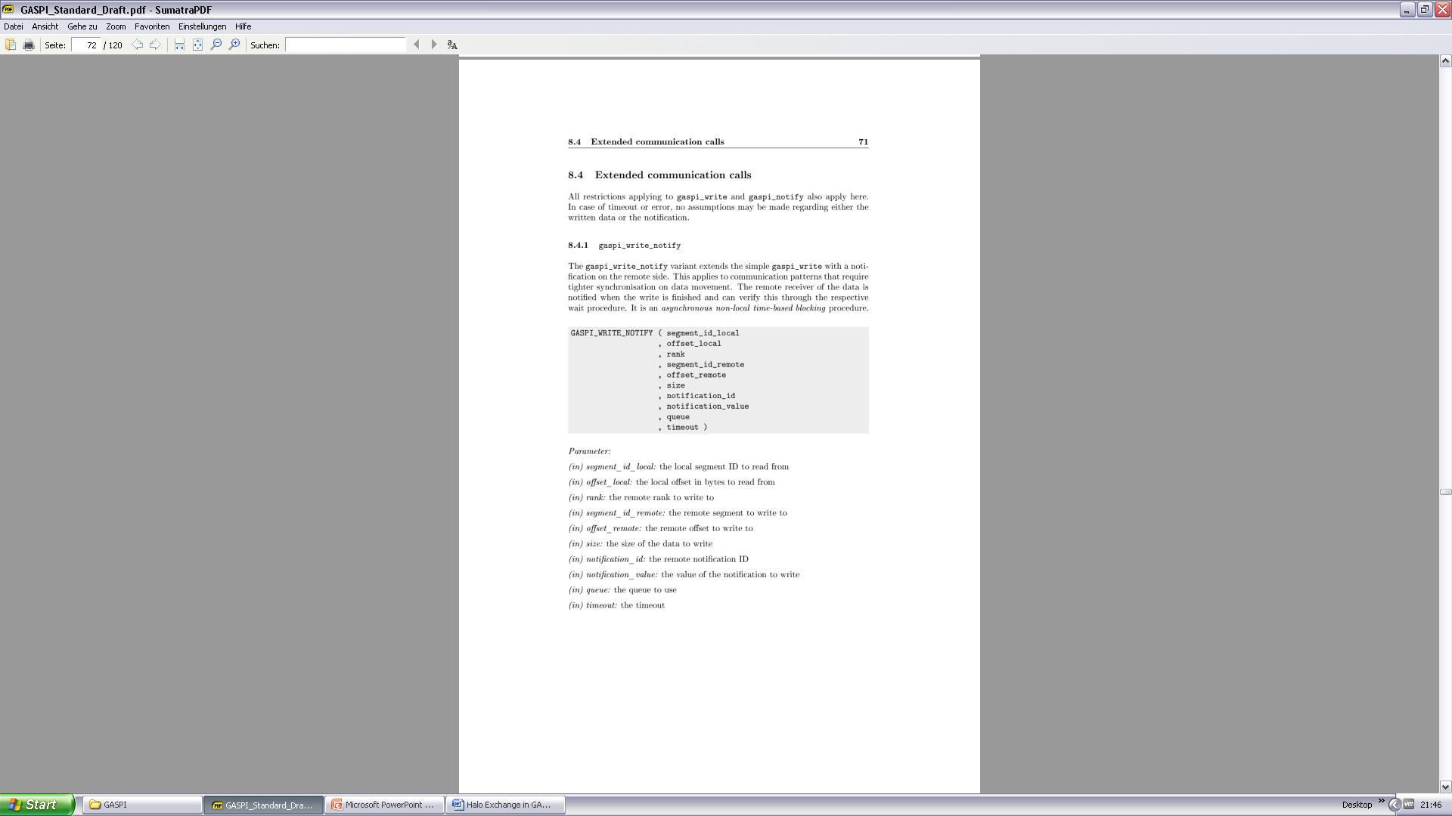
The GASPI API
52 communication functions
24 getter/setter functions
108 pages
… but in reality:
Init/Term
Segments
Read/Write
Passive Communication
Global Atomic Operations
Groups and collectives
www.gaspi.de

Slide 28
Execution Model

Slide 29
GASPI Execution Model
SPMD / MPMD execution model
All procedures have prefix gaspi_
All procedures have a return value
Timeout mechanism for potentially blocking procedures

Slide 30
GASPI Return Values
Procedure return values:
GASPI_SUCCESS
designated operation successfully completed
GASPI_TIMEOUT
designated operation could not be finished in the given time
not necessarily an error
the procedure has to be invoked subsequently in order to fully complete the designated operation
GASPI_QUEUE_FULL
Request could not be posted to queue. End of queue has been reached, change queue or wait
GASPI_ERROR
designated operation failed -> check error vector
Advice: Always check return value !

Slide 31
success_or_die.h
#ifndef SUCCESS_OR_DIE_H
#define SUCCESS_OR_DIE_H
#include <GASPI.h>
#include <stdlib.h>
#define SUCCESS_OR_DIE(f...) \
do \
{ \
const gaspi_return_t r = f; \
\
if (r != GASPI_SUCCESS) \
{ \
printf ("Error: '%s' [%s:%i]: %i\n", #f, __FILE__, __LINE__, r);\
exit (EXIT_FAILURE); \
} \
} while (0)
#endif

Slide 32
Timeout Mechanism
Mechanism for potentially blocking procedures
procedure is guaranteed to return
Timeout: gaspi_timeout_t
GASPI_TEST (0)
procedure completes local operations
Procedure does not wait for data from other processes
GASPI_BLOCK (-1)
wait indefinitely (blocking)
Value > 0
Maximum time in msec the procedure is going to wait for data from other ranks to make progress
!= hard execution time

Slide 33
GASPI Process Management
Initialize / Finalize
gaspi_proc_init
gaspi_proc_term
Process identification
gaspi_proc_rank
gaspi_proc_num
Process configuration
gaspi_config_get
gaspi_config_set

Slide 34
GASPI Initialization
initialization of resources
set up of communication infrastructure if requested
set up of default group GASPI_GROUP_ALL
rank assignment
position in machinefile ⬄ rank ID
no default segment creation
gaspi_proc_init

Slide 35
GASPI Finalization
clean up
wait for outstanding communication to be finished
release resources
no collective operation !
gaspi_proc_term

Slide 36
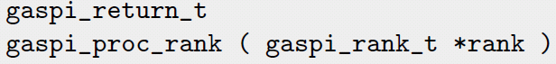
GASPI Process Identification
gaspi_proc_num
gaspi_proc_rank

Slide 37
GASPI Startup
gaspi_run
Usage: gaspi_run –m <machinefile>[OPTIONS] <path2bin>
Available options:
-b <binary file> Use a different binary for master
-N Enable NUMA for procs on same node
-n <procs> start as many <procs> from machinefile -d Run with gdb on master node

Slide 38
Hello world – Hands on
Write a GASPI „Hello World“ program which outputs
Hello world from rank xxx of yyy
Use hands_on/helloworld.c as starting point
Use SUCCESS_OR_DIE macro to check for return values
Use the debug library (libGPI2-dbg.a)
Execute the Hello World program and explore the several options of gaspi_run

Slide 39
GASPI „hello world“
#include "success_or_die.h“
#include <GASPI.h>
#include <stdlib.h>
int main(int argc, char *argv[])
{
SUCCESS_OR_DIE( gaspi_proc_init(GASPI_BLOCK) );
gaspi_rank_t rank;
gaspi_rank_t num;
SUCCESS_OR_DIE( gaspi_proc_rank(&rank) );
SUCCESS_OR_DIE( gaspi_proc_num(&num) );
printf("Hello world from rank %d of %d\n",rank, num);
SUCCESS_OR_DIE( gaspi_proc_term(GASPI_BLOCK) );
return EXIT_SUCCESS;
}

Slide 40
Memory Segments

Slide 41
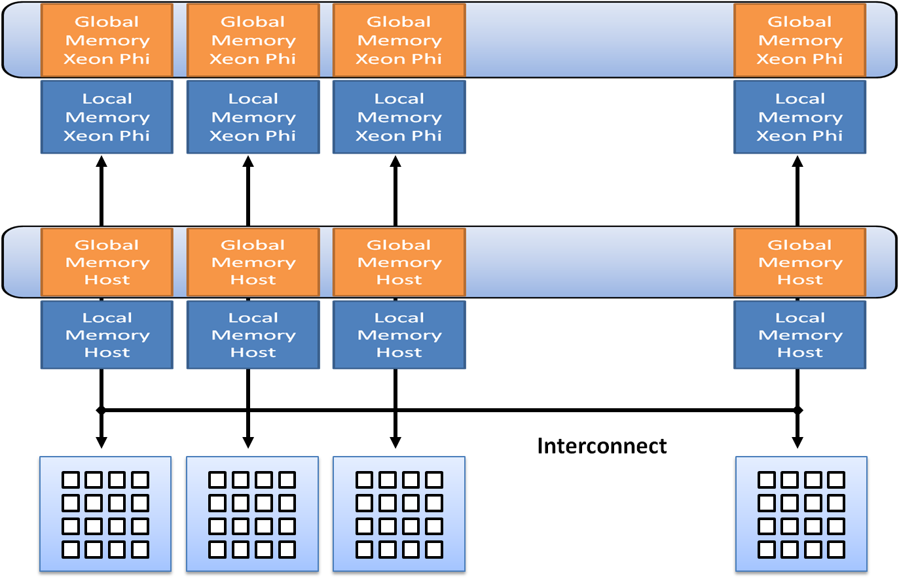
Segments

Slide 42
Segments
Software abstraction of hardware memory hierarchy
NUMA
GPU
Xeon Phi
One partition of the PGAS
Contiguous block of virtual memory
no pre-defined memory model
memory management up to the application
Locally / remotely accessible
local access by ordinary memory operations
remote access by GASPI communication routines

Slide 43
GASPI Segments
GASPI provides only a few relatively large segments
segment allocation is expensive
the total number of supported segments is limited by hardware constraints
GASPI segments have an allocation policy
GASPI_MEM_UNINITIALIZED
memory is not initialized
GASPI_MEM_INITIALIZED
memory is initialized (zeroed)

Slide 44
Segment Functions
Segment creation
gaspi_segment_alloc
gaspi_segment_register
gaspi_segment_create
Segment deletion
gaspi_segment_delete
Segment utilities
gaspi_segment_num
gaspi_segment_ptr

Slide 45
GASPI Segment Allocation
allocate and pin for RDMA
Locally accessible
gaspi_segment register
segment accessible by rank
gaspi_segment_alloc

Slide 46
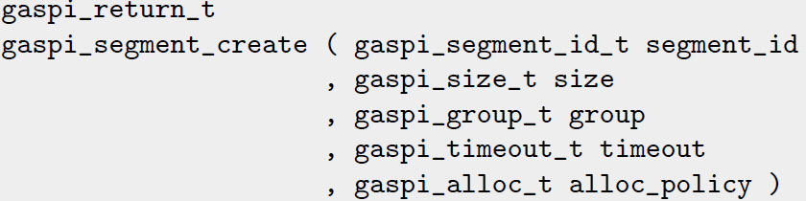
GASPI Segment Creation
Collective short cut to
gaspi_segment_alloc
gaspi_segment_register
After successful completion, the segment is locally and remotely accessible by all ranks in the group
gaspi_segment_create

Slide 47
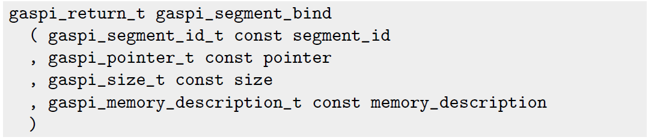
GASPI Segment with given Buffer
gaspi_segment_bind
Binds a buffer to a particular segment
Same capabilities as allocated/created segment
Locally accessible (requires gaspi_segment_register)

Slide 48
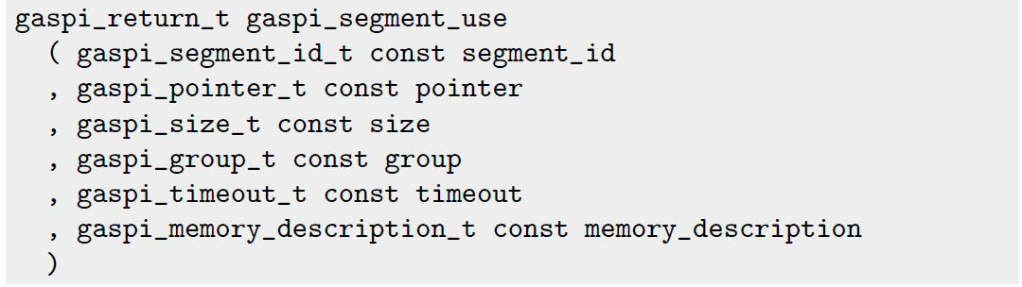
GASPI Segment with given Buffer
gaspi_segment_use
Equivalent to

Slide 49
GASPI Segment Deletion
Free segment memory
gaspi_segment_delete

Slide 50
GASPI Segment Utils
gaspi_segment_list
gaspi_segment_ptr
gaspi_segment_num

Slide 51
GASPI Segment Utils
Maximum number of segments
Defines range of allowed segment IDs [0,segment_max - 1)
gaspi_segment_max

Slide 52
Using Segments – Hands on
Write a GASPI program which stores a NxM matrix in a distributed way: 1 row per process
Create a segment
Initialize the segment
output the result
0 | 1 | … | M-1
M | M+1 | … | 2M-1
(N-1)M | (N-1)M+1 | … | NM-1
Row 0
Row 1
Row N-1

Slide 53
Using Segments (I)
// includes
int main(int argc, char *argv[])
{
static const int VLEN = 1 << 2;
SUCCESS_OR_DIE( gaspi_proc_init(GASPI_BLOCK) );
gaspi_rank_t iProc, nProc;
SUCCESS_OR_DIE( gaspi_proc_rank(&iProc));
SUCCESS_OR_DIE( gaspi_proc_num(&nProc));
gaspi_segment_id_t const segment_id = 0;
gaspi_size_t const segment_size = VLEN * sizeof (double);
SUCCESS_OR_DIE ( gaspi_segment_create ( segment_id, segment_size , GASPI_GROUP_ALL, GASPI_BLOCK
, GASPI_MEM_UNINITIALIZED ) );

Slide 54
Using Segments (II)
gaspi_pointer_t array;
SUCCESS_OR_DIE( gaspi_segment_ptr (segment_id, &array) );
for (int j = 0; j < VLEN; ++j)
{
((double *)array )[j]= (double)( iProc * VLEN + j );
printf( "rank %d elem %d: %f \n„
, iProc,j,( (double *)array )[j] );
}
SUCCESS_OR_DIE( gaspi_proc_term(GASPI_BLOCK) );
return EXIT_SUCCESS;
}

Slide 55
One-sided Communication

Slide 56
GASPI One-sided Communication
Post a put request into a given queue for transfering data from a local segment into a remote segment
gaspi_write

Slide 57
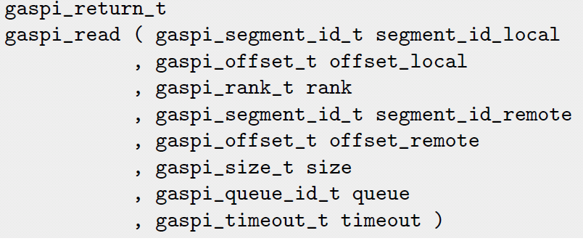
GASPI One-sided Communication
Post a get request into a given queue for transfering data from a remote segment into a local segment
gaspi_read

Slide 58
GASPI One-sided Communication
Wait on local completion of all requests in a given queue
After successfull completion, all involved local buffers are valid
gaspi_wait

Slide 59
Queues (I)
Different queues available to handle the communication requests
Requests to be submitted to one of the supported queues
Advantages
More scalability
Channels for different types of requests
Similar types of requests are queued and synchronized together but independently from other ones
Separation of concerns
Asynchronous execution, thin abstraction of HW queues.

Slide 60
Queues (II)
Fairness of transfers posted to different queues is guaranteed
No queue should see ist communication requests delayed indefinitely
A queue is identified by its ID
Synchronization of calls by the queue
Queue order does not imply message order on the network / remote memory
A subsequent notify call is guaranteed to be non-overtaking for all previous posts to the same queue and rank

Slide 61
Queues (III)
Queues have a finite capacity
Queues are not automatically flushed
Maximize time between posting the last request and flushing the queue (qwait)
Return value GASPI_QUEUE_FULL indicates full queue.

Slide 62
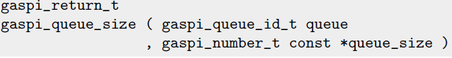
GASPI Queue Utils
gaspi_queue_size_max
gaspi_queue_size

Slide 63
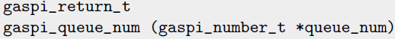
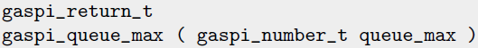
GASPI Queue Utils
gaspi_queue_max
gaspi_queue_num

Slide 64
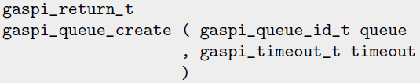
GASPI Queue Utils
gaspi_queue_delete
gaspi_queue_create

Slide 65
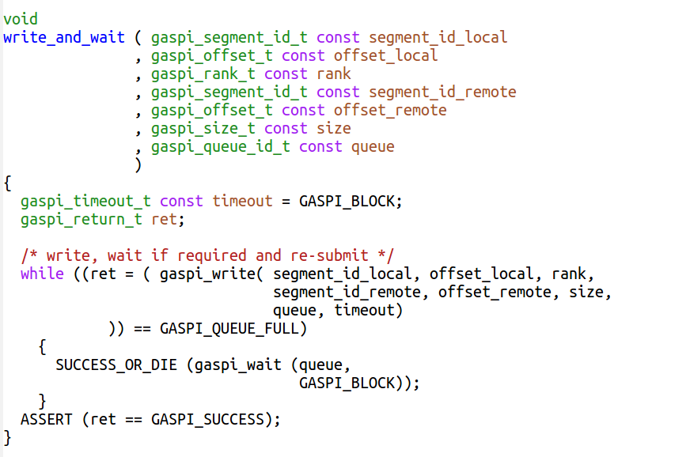
write_and_wait
serial wait on queue
sanity checks

Slide 66
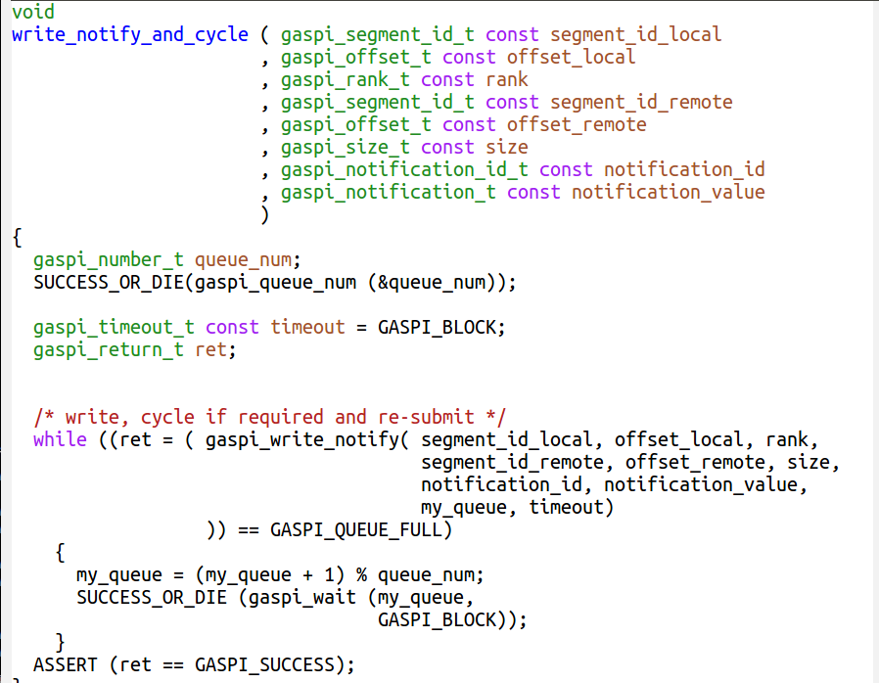
write_notify_and_cycle
cycle through queues
sanity checks

Slide 67
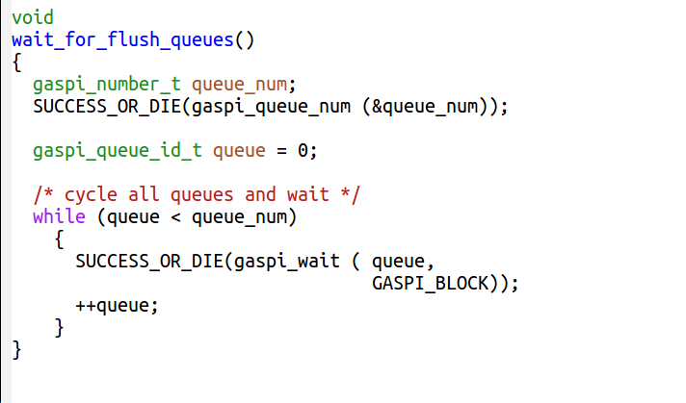
wait_for_flush_queues
flush all queues

Slide 68
Data Synchronization By Notification
One sided-communication:
Entire communication managed by the local process only
Remote process is not involved
Advantage: no inherent synchronization between the local and the remote process in every communication request
Still: At some point the remote process needs knowledge about data availability
Managed by notification mechanism

Slide 69
GASPI Notification Mechanism
Several notifications for a given segment
Identified by notification ID
Logical association of memory location and notification

Slide 70
GASPI Notification Mechanism
Posts a notification with a given value to a given queue
Remote visibility guarantees remote data visibility of all previously posted writes in the same queue, the same segment and the same process rank
gaspi_notify

Slide 71
GASPI Notification Mechanism
Monitors a contiguous subset of notification id‘s for a given segment
Returns successfull if at least one of the monitored id‘s is remotely updated to a value unequal zero
gaspi_notify_waitsome

Slide 72
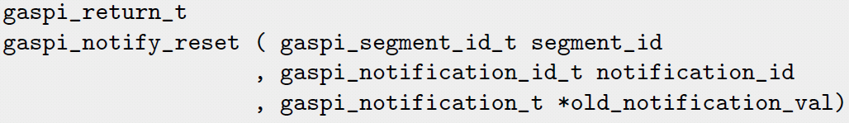
GASPI Notification Mechanism
Atomically resets a given notification id and yields the old value
gaspi_notify_reset

Slide 73
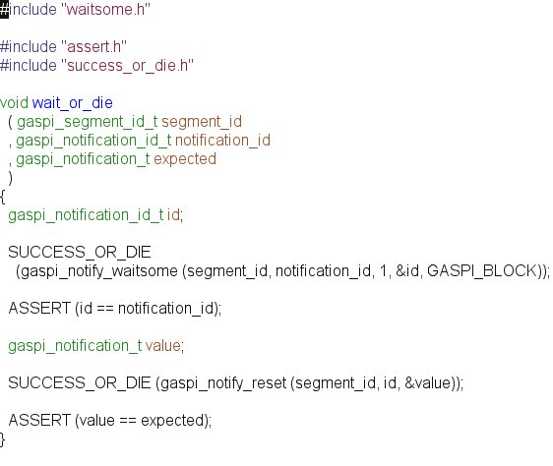
wait_or_die
Wait for a given notification and reset
Sanity checks

Slide 74
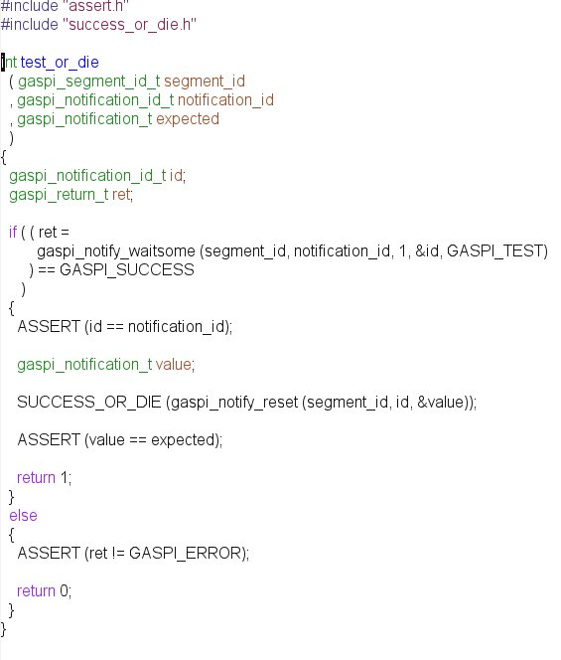
test_or_die
Test for a given notification and reset
Sanity checks

Slide 75
Extended One-sided Calls
Hardware Optimized
gaspi_write_notify
write + subsequent gaspi_notify, unordered with respect to „other“ writes.
gaspi_write_list
several subsequent gaspi_writes to the same rank
gaspi_write_list_notify
gaspi_write_list + subsequent gaspi_notify, non-ordered with respect to „other“ writes.
gaspi_read_list
Several subsequent read from the same rank.
gaspi_read_notify
read + subsequent gaspi_notify, unordered with respect to „other“ writes.

Slide 76
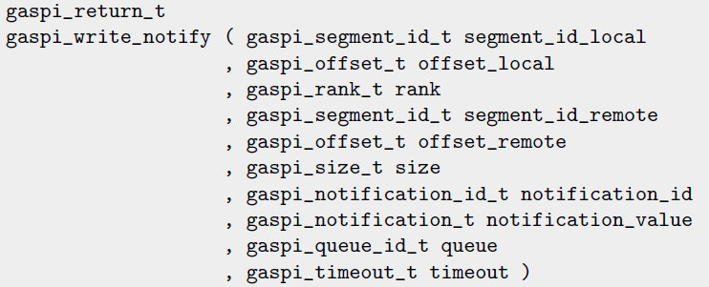
GASPI extended one-sided
gaspi_write with subsequent gaspi_notify
Unordered relative to other communication (!)
gaspi_write_notify

Slide 77
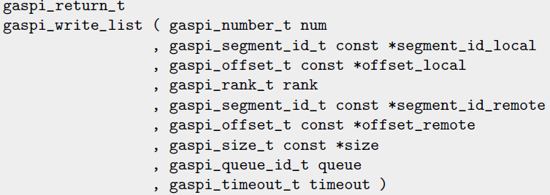
GASPI extended one-sided
Several subsequent gaspi_write
gaspi_write_list

Slide 78
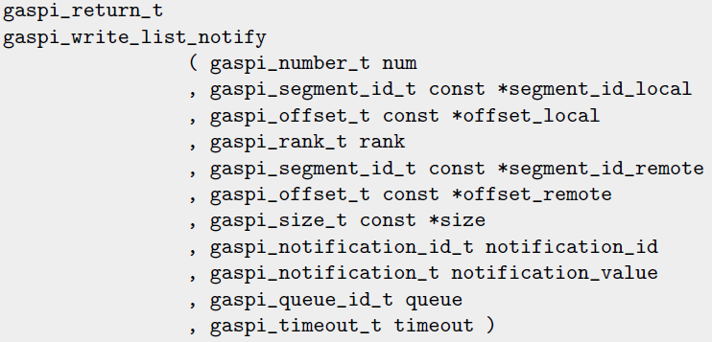
GASPI extended one-sided
several subsequent gaspi_write and a notification
Unordered relative to other communication (!)
gaspi_write_list_notify

Slide 79
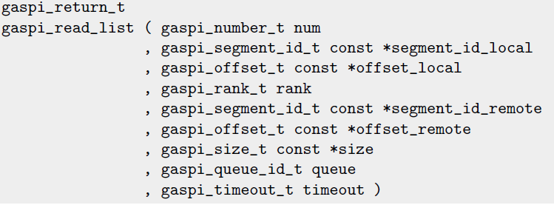
GASPI extended one-sided
several subsequent gaspi_read
gaspi_read_list

Slide 80

GASPI extended one-sided
gaspi_read_notify
„gaspi_read with subsequent gaspi_notify“
Unordered relative to other communication (!)

Slide 81
Communication – Hands on
Take your GASPI program which stores a NxM matrix in a distributed way and extend it by communication for rows
Create a segment ( sufficient size for a source and target row)
Initialize the segment
0 | 1 | … | M-1
M | M+1 | … | 2M-1
(N-1)M | (N-1)M+1 | … | NM-1
Row 0
Row 1
Row N-1

Slide 82
Communication – Hands on
Take your GASPI program which stores a NxM matrix in a distributed way and extend it by communication
Communicate your row to your right neighbour (periodic BC)
Check that the data is available
Output the result
write_notify
notify_waitsome
Row 0
Row N-1
Row 1
Row 0
Row N-1
Row N-2

Slide 83
onesided.c (I)
// includes
int main(int argc, char *argv[])
{
static const int VLEN = 1 << 2;
SUCCESS_OR_DIE( gaspi_proc_init(GASPI_BLOCK) );
gaspi_rank_t iProc, nProc;
SUCCESS_OR_DIE( gaspi_proc_rank(&iProc));
SUCCESS_OR_DIE( gaspi_proc_num(&nProc));
gaspi_segment_id_t const segment_id = 0;
gaspi_size_t const segment_size = 2 * VLEN * sizeof (double);
SUCCESS_OR_DIE ( gaspi_segment_create ( segment_id, segment_size , GASPI_GROUP_ALL, GASPI_BLOCK
, GASPI_MEM_UNINITIALIZED ) );
gaspi_pointer_t array;
SUCCESS_OR_DIE ( gaspi_segment_ptr (segment_id, &array) );
double * src_array = (double *)(array);
double * rcv_array = src_array + VLEN;
for (int j = 0; j < VLEN; ++j) {
src_array[j]= (double)( iProc * VLEN + j ); }

Slide 84
/* write, cycle if required and re-submit */
while ((ret = ( gaspi_write_notify( segment_id_local, offset_local, rank,
segment_id_remote, offset_remote, size,
notification_id, notification_value,
my_queue, timeout)
)) == GASPI_QUEUE_FULL) {
my_queue = (my_queue + 1) % queue_num;
SUCCESS_OR_DIE (gaspi_wait (my_queue,
GASPI_BLOCK));
}
ASSERT (ret == GASPI_SUCCESS);
gaspi_notification_id_t data_available = 0;
gaspi_offset_t loc_off = 0;
gaspi_offset_t rem_off = VLEN * sizeof (double);
write_notify_and_cycle ( segment_id
, loc_off
, RIGHT (iProc, nProc)
, segment_id
, rem_off
, VLEN * sizeof (double)
, data_available
, 1 + iProc
);
wait_or_die (segment_id, data_available, 1 + LEFT (iProc, nProc) );
for (int j = 0; j < VLEN; ++j)
{ printf("rank %d rcv elem %d: %f \n", iProc,j,rcv_array[j] ); }
wait_for_flush_queues();
SUCCESS_OR_DIE( gaspi_proc_term(GASPI_BLOCK) );
return EXIT_SUCCESS;}

Slide 85
Ping-Pong

Slide 86
Ping-Ping – Hands-On
message_rate.c
Wait for incoming notifications (and reset them)
message_ping_pong.c
Acknowledge incoming bulk of notifications.
message_ping_ping.c
Directly return all incoming notifications
fairness_between_queues.c
Fairness between queues
using_GASPI_TEST.c
Multithreaded testing for incoming notifications

Slide 87
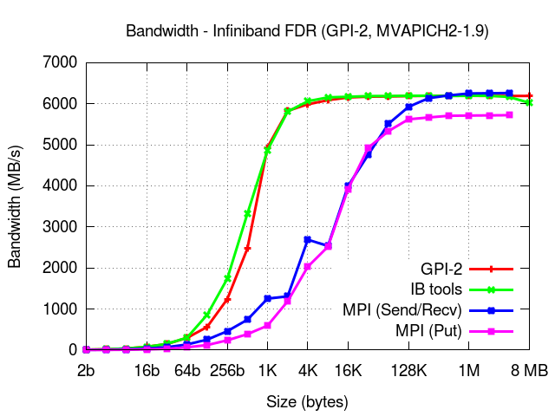
GPI 2.0 - Bandwidth

Slide 88
Collectives

Slide 89
Collective Operations (I)
Collectivity with respect to a definable subset of ranks (groups)
Each GASPI process can participate in more than one group
Defining a group is a three step procedure
gaspi_group_create
gaspi_group_add
gaspi_group_commit
GASPI_GROUP_ALL is a predefined group containing all processes

Slide 90
Collective Operations (II)
All gaspi processes forming a given group have to invoke the operation
In case of a timeout (GASPI_TIMEOUT), the operation is continued in the next call of the procedure
A collective operation may involve several procedure calls until completion
Completion is indicated by return value GASPI_SUCCESS

Slide 91
Collective Operations (III)
Collective operations are exclusive per group
Only one collective operation of a given type on a given group at a given time
Otherwise: undefined behaviour
Example
Two allreduce operations for one group can not run at the same time
An allreduce operation and a barrier are allowed to run at the same time

Slide 92
Collective Functions
Built in:
gaspi_barrier
gaspi_allreduce
GASPI_OP_MIN, GASPI_OP_MAX, GASPI_OP_SUM
GASPI_TYPE_INT, GASPI_TYPE_UINT, GASPI_TYPE_LONG, GASPI_TYPE_ULONG, GASPI_TYPE_FLOAT, GASPI_TYPE_DOUBLE
User defined
gaspi_allreduce user

Slide 93
GASPI Collective Function
gaspi_allreduce
gaspi_barrier

Slide 94
Passive communication

Slide 95
Passive Communication Functions (I)
2 sided semantics send/recv
gaspi_passive_send
time based blocking

Slide 96
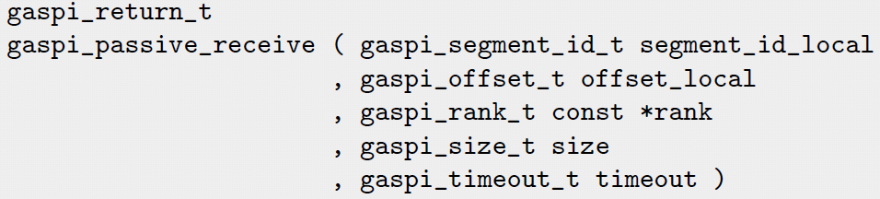
Passive Communication Functions (II)
Gaspi_passive receive
Time based blocking
Sends calling thread to sleep
Wakes up calling thread in case of incoming message or given timeout has been reached

Slide 97
Passive Communication Functions (III)
Higher latency than one-sided comm.
Use cases:
Parameter exchange
management tasks
„Passive“ Active Messages (see advanced tutorial code)
GASPI Swiss Army Knife.

Slide 98
Passive Communication Functions (III)
Example: Negotiate offsets for alltoallV communication
Set local send offsets, local receive offsets and remote receive offsets.
Use passive communication for serializing incoming traffic in order to determine linear alltoallV workarrays.
Use passive communication to trigger remote printing of received data.

Slide 99
Passive Communication Functions (IV)
void *handle_passive(void *arg)
{ gaspi_pointer_t _vptr;
SUCCESS_OR_DIE(gaspi_segment_ptr(passive_segment, &_vptr));
const gaspi_offset_t passive_offset = sizeof(packet);
while(1)
{
gaspi_rank_t sender;
SUCCESS_OR_DIE(gaspi_passive_receive(passive_segment
, passive_offset
, &sender
, sizeof(packet)
, GASPI_BLOCK
));
packet *t = (packet *) ((char*)_vptr + sizeof(packet));
return_offset(t->rank, t->len, t->offset)
}
return NULL;

Slide 100
Fault Tolerance

Slide 101
Features
Implementation of fault tolerance is up to the application
But: well defined and requestable state guaranteed at any time by
Timeout mechanism
Potentially blocking routines equipped with timeout
Error vector
contains health state of communication partners
Dynamic node set
substitution of failed processes

Slide 102
Interoperability with MPI

Slide 103
Interoperability with MPI
GASPI supports interoperability with MPI in a so-called mixed-mode.
The mixed-mode allows for
either entirely porting an MPI application to GASPI
or replacing performance-critical parts of an MPI based application with GASPI code (useful when dealing with large MPI code bases)
Porting guides available at:
http://www.gpi-site.com/gpi2/docs/whitepapers/

Slide 104
Mixing GASPI and MPI in Parallel Programs
GASPI must be installed with MPI support, using the option
--with-mpi <path_to_mpi_installation>
MPI must be initialized before GASPI, as shown in the joined example
The same command or script as the one provided by the MPI installation should be used for starting programs (mpirun or similar)
gaspi_run should not be used!
#include <assert.h>
#include <GASPI.h>
#include <mpi.h>
int main (int argc, char *argv[])
{
// initialize MPI and GASPI
MPI_Init (&argc, &argv);
gaspi_proc_init (GASPI_BLOCK);
// Do work …
// shutdown GASPI and MPI
gaspi_proc_term (GASPI_BLOCK);
MPI_Finalize();
return 0;
}

Slide 105
GASPI Preserves the MPI Ranks
GASPI is able to detect at runtime the MPI environment and to setup its own environment based on this
GASPI can deliver the same information about ranks and number of processes as MPI
This helps to preserve the application logic
…
int nProc_MPI, iProc_MPI;
gaspi_rank_t iProc, nProc;
MPI_Init(&argc, &argv);
MPI_Comm_rank (MPI_COMM_WORLD, &iProc_MPI);
MPI_Comm_size (MPI_COMM_WORLD, &nProc_MPI);
SUCCESS_OR_DIE (gaspi_proc_ini(GASPI_BLOCK));
SUCCESS_OR_DIE (gaspi_proc_rank (&iProc));
SUCCESS_OR_DIE (gaspi_proc_num (&nProc));
ASSERT(iProc == iProc_MPI);
ASSERT(nProc == nProc_MPI);
…

Slide 106
Using User Provided Memory for Segments
New feature added in version 1.3 of GASPI: a user may provide already allocated memory for segments
Memory used in MPI communication can be used in GASPI communication
However, the feature should be used with care because the segment creation is an expensive operation
//initialize and allocate memory
double *buffer = calloc ( num_elements , sizeof(double)
);
gaspi_segment_id_t segment_id = 0;
//use the allocated buffer as underlying //memory support for a segment
SUCCESS_OR_DIE
( gaspi_segment_use
, segment_id
, buffer
, n*sizeof (double)
, GASPI_GROUP_ALL
, GASPI_BLOCK
, 0
);

Slide 107
Using GASPI Segment Allocated Memory in MPI Communication
// allgatherV
SUCCESS_OR_DIE (gaspi_segment_create ( segment_id
, vlen * sizeof(int), GASPI_GROUP_ALL, GASPI_BLOCK
, GASPI_ALLOC_DEFAULT));
gaspi_pointer_t _ptr = NULL;
SUCCESS_OR_DIE (gaspi_segment_ptr (segment_id, &_ptr));
int *array = (int *) _ptr;
init_array(array, offset, size, iProc, nProc);
MPI_Allgatherv(&array[offset[iProc]], size[iProc], MPI_INT
, array, size, offset, MPI_INT, MPI_COMM_WORLD);

Slide 108
Mixing MPI Code with GASPI Code From a Library
int n, my_mpi_rank, n_mpi_procs;
MPI_Init (&argc, &argv);
MPI_Comm_rank (MPI_COMM_WORLD, &my_mpi_rank);
MPI_Comm_size (MPI_COMM_WORLD, &n_mpi_procs);
SUCCESS_OR_DIE (gaspi_proc_init, GASPI_BLOCK);
// initialize data
// distribute data, do MPI communication
// call GPI library function for iteratively
// solving a linear system
Gaspi_Jacobi( n, n_local_rows, local_a, , local_b, &x, x_new, n_max_iter, tol
);
SUCCESS_OR_DIE (gaspi_proc_term, GASPI_BLOCK);
MPI_Finalize();
In mixed-mode, an MPI based code may call GASPI code that is embedded into a library
The GASPI environment must be initialized and cleaned up within the calling program

Slide 109
Interoperability - Hands on
Implement allgatherV
Local array size M_SZ*2^(rank)
// init MPI/GASPI
int const B_SZ = 2;
int const M_SZ = 2048;
int *offset = malloc(nProc * sizeof(int));
ASSERT(offset != NULL);
int *size = malloc(nProc * sizeof(int));
ASSERT(size != NULL);
int vlen = 0;
int i, k = 1;
for (i = 0; i < nProc; ++i)
{
offset[i] = vlen;
size[i] = M_SZ * k;
vlen += size[i];
k *= B_SZ;
}

Slide 110
Interoperability - Hands on - II
Modify the above MPI program, such that the GASPI environment is initialized after MPI
Check if the MPI ranks and GASPI ranks are identical
Create a GASPI segment
Use GASPI segment allocated memory as a communication buffer in the MPI allgatherV operation

Slide 111
The GASPI programming model

Slide 112
Think performance
Asynchronous execution with maximal overlap of communication and computation

Slide 113
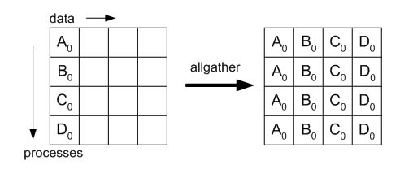
Example: allgatherV
Complete the ‚folklore‘ round-robin algorithm

Slide 114
Example: allgatherV
Complete the ‚pipelined‘ algorithm, (allscatter + broadcast)
Scatter all data
A
A
A
Broadcast all scattered parts
A
A
A
A
A

Slide 115
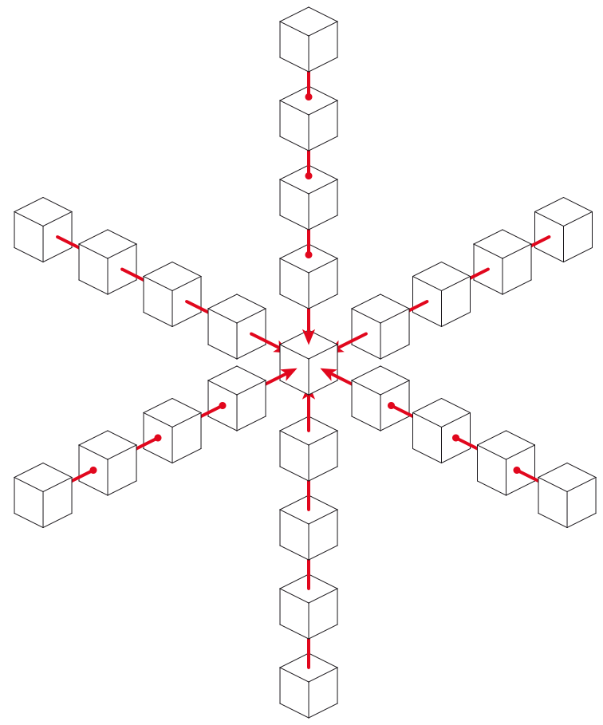
Example: Stencil applications
Important class of algorithms
FD methods
Image processing
PDEs
Iterative method
Non-local updates -> data dependencies

Slide 116
Stencil application proxy
2 buffers per element
Buffer 0
Buffer 1
2 vectors per buffer
Upper vector
Lower vector
Data dependencies
Left element
Right element
Buffer 0
Upper Vector
Update cycle
Lower Vector
Buffer 1
Upper Vector
Lower Vector
Update step:
- Update upper part
- Update lower part

Slide 117
Stencil application proxy
Buffer 0
Upper Vector
Lower Vector
Upper Vector
Buffer 1
Lower Vector
Nthread omp threads
static domain decomposition / assignment
Two buffers per thread
Two vectors per buffer
Vector length: nvector
tid2
tid0
tid3
tid1

Slide 118
Iteration 1
Upper half: move to the right
Lower half: move to the left
Periodic BC
Periodic BC
barrier

Slide 119
Iteration 2
Periodic BC
Periodic BC
Upper half: move to the right
Lower half: move to the left
barrier

Slide 120
Iteration 3
Upper half: move to the right
Lower half: move to the left
Periodic BC
Periodic BC
barrier

Slide 121
Iteration 4
Periodic BC
Periodic BC
Upper half: move to the right
Lower half: move to the left
barrier

Slide 122
Nelem many iterations:
Initial configuration recovered
-> Easy to check

Slide 123
Temporal evolution
single iteration
tid 0
tid 1
tid 2
tid 3
Fork / barrier
Join / barrier
Time

Slide 124
More than one process …

Slide 125
Elementary update
Each process hosts some part of the information
Part of the information is no longer directly accessible

Slide 126
Boundary / Halo domains

Slide 128
Bulk Synchronous
Separate communication / computation phases

Slide 129
Communication phase
barrier
barrier

Slide 130
Computation phase
barrier
barrier

Slide 131
Communication phase
barrier
barrier

Slide 132
Computation phase
barrier
barrier

Slide 133
Hands-on
Implement the bulk-synchronous algorithm
use left_right_double_buffer_funneled.c as template

Slide 134
The GASPI Ring Exchange
if (tid == 0) {
// issue write
write_notify_and_cycle
( .. , LEFT(iProc, nProc),., right_data_available[buffer_id], 1 + i);
// issue write
write_notify_and_cycle
( .., RIGHT(iProc, nProc),., left_data_available[buffer_id], 1 + i);
}
#pragma omp barrier
data_compute ( NTHREADS, array, 1 - buffer_id, buffer_id, slice_id);
#pragma omp barrier
buffer_id = 1 - buffer_id;
GASPI – left_right_double_buffer_funneled.c

Slide 135
Excursion: Efficient parallel execution
Basic ingredients

Slide 136
Efficient parallel execution
Q: What is the measure for „efficient parallel execution“ ?
A: Scalability

Slide 137
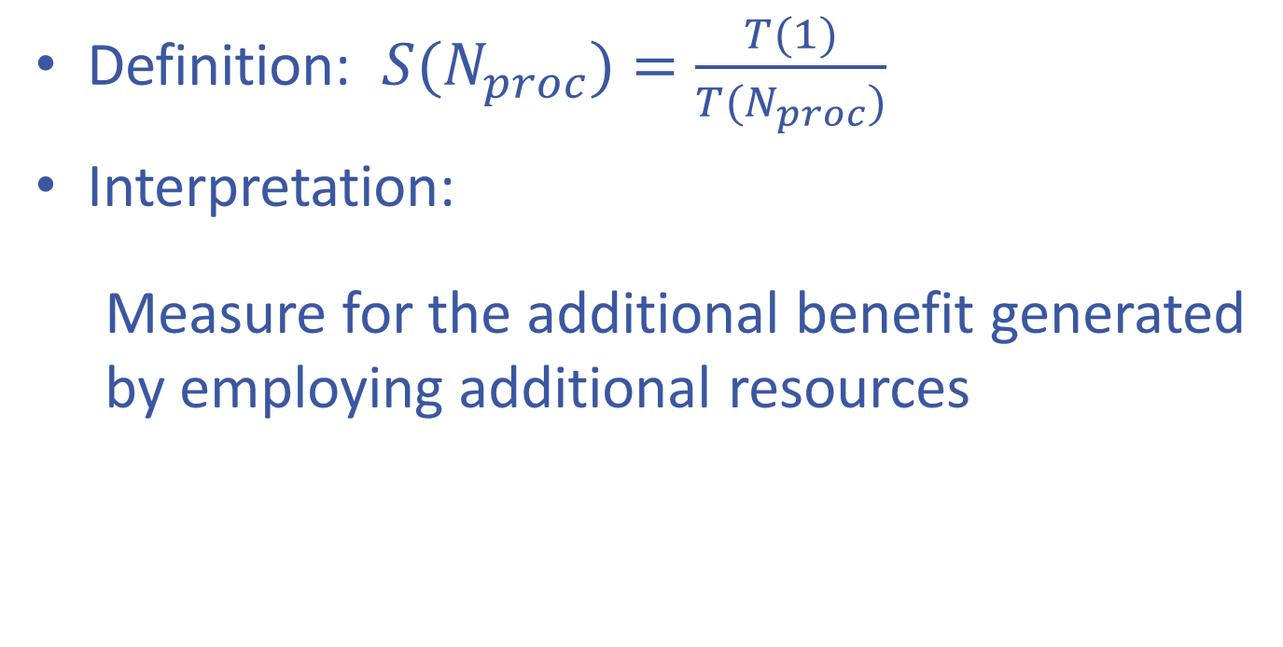
Efficient parallel execution
sc

Slide 138
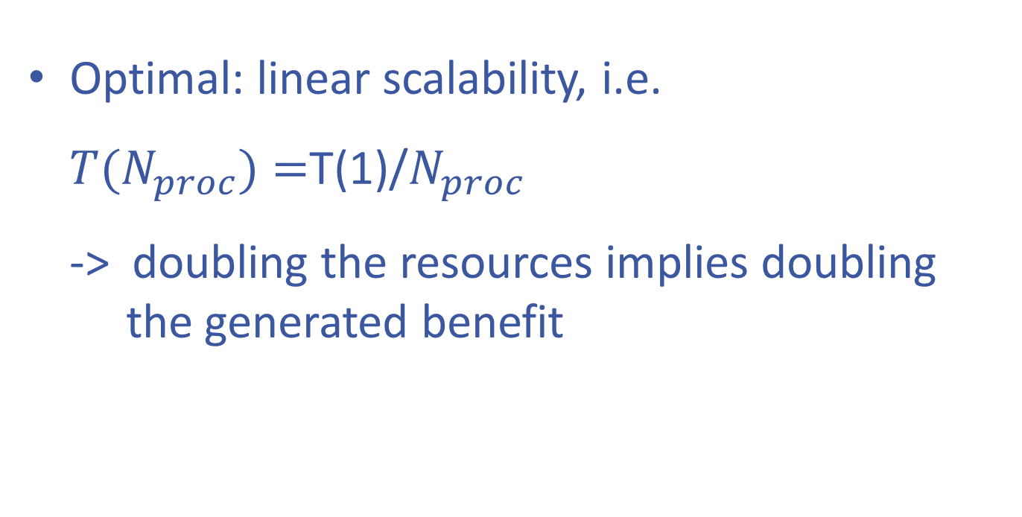
Scalability S
Optimal: linear scalability, i.e. $T(N_{proc})=$T(1)/$N_{proc}$ -> doubling the resources implies doubling the generated benefit

Slide 139
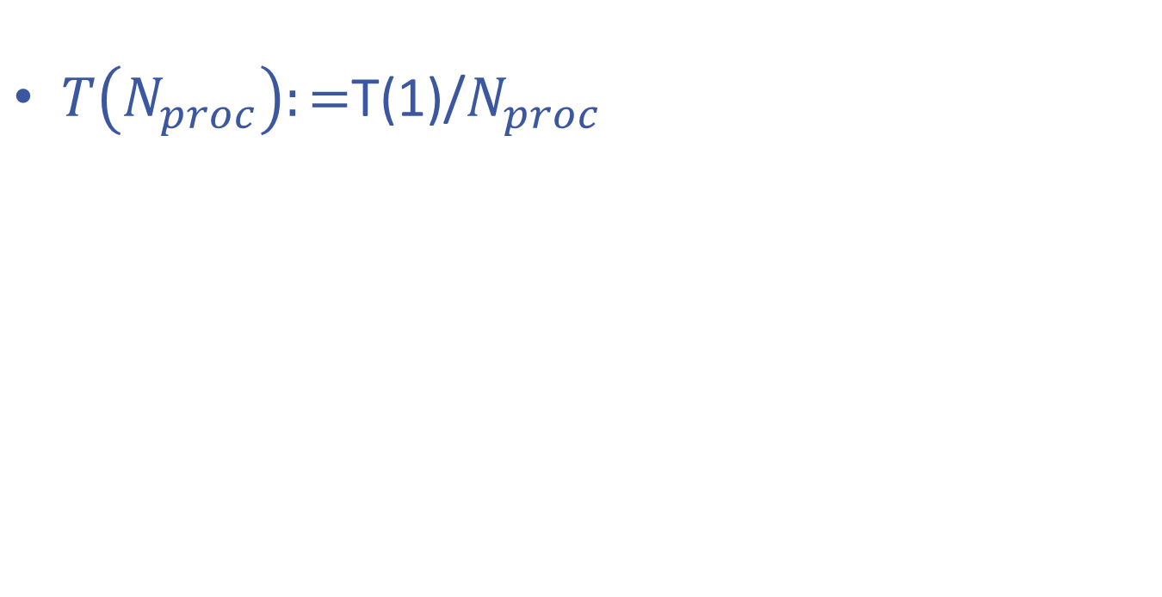
Implications for parallelization
$T\left(N_{proc}\right):=$T(1)/$N_{proc}$
T(1)
T(4) = T(1) / 4
Time

Slide 140
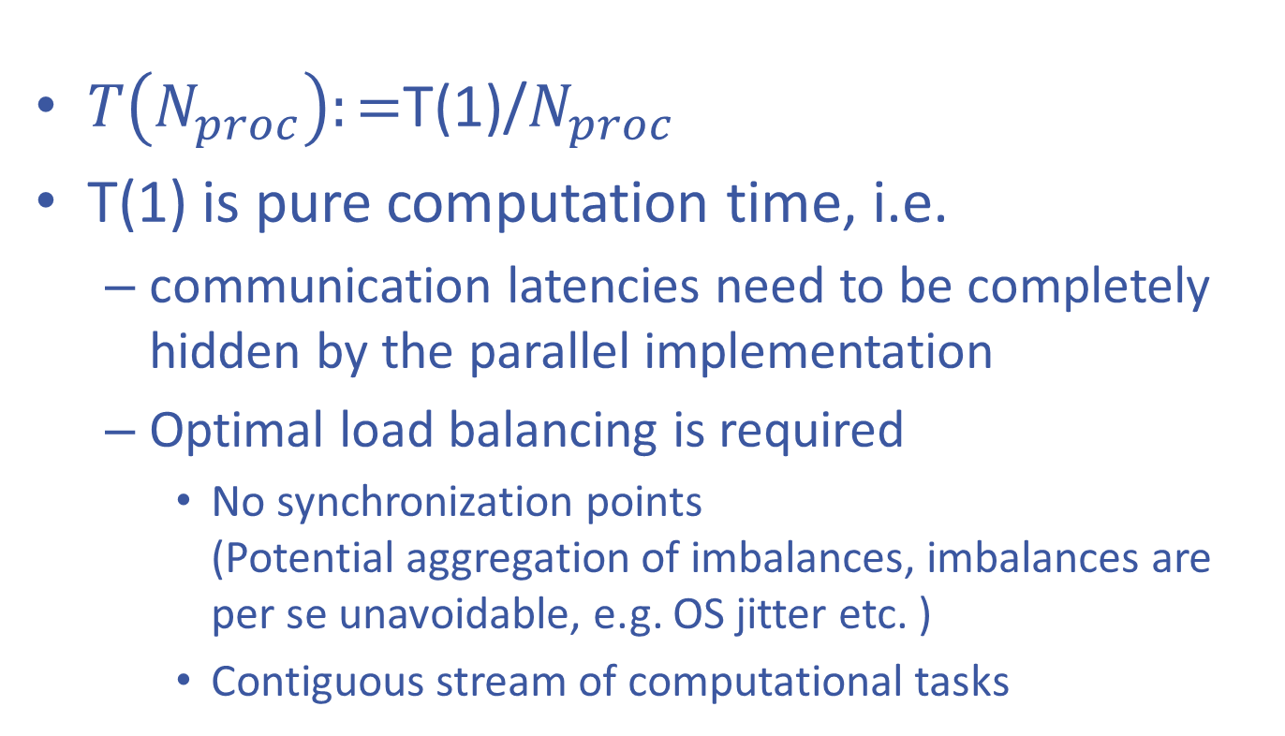
Implications for parallelization
$T\left(N_{proc}\right):=$T(1)/$N_{proc}$
T(1) is pure computation time, i.e.
communication latencies need to be completely hidden by the parallel implementation
Optimal load balancing is required
No synchronization points (Potential aggregation of imbalances, imbalances are per se unavoidable, e.g. OS jitter etc. )
Contiguous stream of computational tasks

Slide 141
End of Excursion

Slide 142
Temporal evolution: one iteration
comm.
comp.
tid 0
tid 1
tid 2
tid 3
Time

Slide 143
Temporal evolution: one iteration
bad: explicitly visible communication latency
comm.
comp.
imbalances
tid 0
tid 1
tid 2
tid 3
Time

Slide 144
Temporal evolution: all iterations
bad: barrier aggregates imbalances
tid 0
tid 1
tid 2
tid 3
Time

Slide 145
CommUNICATION / computation overlap
Hide communication behind computation

Slide 146
Strategy
Hide communication latencies behind computation
Split data into inner / boundary part
Inner data ⬄ no dependence on remote information
Boundary data ⬄ has dependence on remote information

Slide 147
Strategy
Algorithmic phases:
Init boundary data transfer
Update inner data along data transfer
Update boundary data

Slide 148
Single iteration
barrier
barrier

Slide 149
Left boundary element:
Single iteration: details
Initiate boundary data transfer to remote halo
barrier
barrier

Slide 150
Left boundary element:
Single iteration: details
Initiate boundary data transfer to remote halo
Wait for boundary data transfer to local halo completion
barrier
barrier

Slide 151
Left boundary element:
Single iteration: details
Initiate boundary data transfer to remote halo
Wait for boundary data transfer to local halo completion
Update vector
barrier
barrier

Slide 152
Left boundary element:
Single iteration: details
Initiate boundary data transfer to remote halo
Wait for boundary data transfer to local halo completion
Update vector
-> Right boundary element handled analogously
barrier
barrier

Slide 153
Left boundary element:
Single iteration: details
Initiate boundary data transfer to remote halo
Wait for boundary data transfer to local halo completion
Update vector
-> Right boundary element handled analogously
barrier
barrier
In the meanwhile inner elements are done in parallel!

Slide 154
Single iteration
barrier
barrier

Slide 155
Hands-on
Implement the overlap of communication and computation
use left_right_double_buffer_multiple.c as template

Slide 156
The GASPI Ring Exchange
GASPI – left_right_double_buffer_multiple.c
if (tid == 0) {
write_notify_and_cycle
( .., LEFT(iProc, nProc),. , right_data_available[buffer_id], 1 + i);
wait_or_die (segment_id, left_data_available[buffer_id], 1 + i);
data_compute ( NTHREADS, array, 1 - buffer_id, buffer_id, slice_id);
} else if (tid < NTHREADS - 1) {
data_compute ( NTHREADS, array, 1 - buffer_id, buffer_id, slice_id);
} else {
write_notify_and_cycle
( .., RIGHT(iProc, nProc),. , left_data_available[buffer_id], 1 + i);
wait_or_die (segment_id, right_data_available[buffer_id], 1 + i);
data_compute ( NTHREADS, array, 1 - buffer_id, buffer_id, slice_id);
}
#pragma omp barrier
buffer_id = 1 - buffer_id;

Slide 157
Temporal evolution
tid 0
tid 1
tid 2
tid 3
Time

Slide 158
Temporal evolution
tid 0
tid 1
tid 2
tid 3
Time

Slide 159
Data dependency Driven
Avoid synchronization point

Slide 160
What has been achieved?
Overlap of communication by computation
Communication latency is (partly) hidden
What has not been achieved?
Fully Asynchronous execution
Still processwide synchronization after each iteration -> process wide aggregation of thread imbalances

Slide 161
Why barrier?
Need to know that buffers are ready for next iteration
Barrier provides too much information !!!
Only need to know that local neighbours (my dependency ) are up to date

Slide 162
Reduce synchronicity
Stage counters
Stage counters
Introduce stage counter for every buffer to account for local states
check neighbourig stage counters before update
In case of match: do update
Increment stage counter after update
-> Only local dependencies remain
Update possible
Update not possible

Slide 163
Avoid static assignment thread / subdomain
Instead: „Task“ for each subdomain
Compute task for inner subdomain
Compute - Initiate data transfer task for boundary subdomains
Pre-Condition check before execution
Left / right neighbor element do not have a higher iteration counter than me
Post-Condition set after execution
Increment iteration counter

Slide 164
The GASPI Ring Exchange
#pragma omp parallel default (none) firstprivate (buffer_id, queue_id) \ shared (array, data_available, ssl, stderr) { slice* sl; while (sl = get_slice_and_lock (ssl, NTHREADS, num)) { handle_slice(sl, array, data_available, segment_id, queue_id, NWAY, NTHREADS, num); omp_unset_lock (&sl->lock); } }
typedef struct slice_t
{
omp_lock_t lock;
volatile int stage;
int index;
enum halo_types halo_type;
struct slice_t *left;
struct slice_t *next;
} slice;
GASPI – Dataflow - left_right_dataflow_halo.c

Slide 165
Hands-on
Implement the data dependency driven algorithm
use slice.c as template
use left_right_dataflow.c as template

Slide 166
The GASPI Ring Exchange
void handle_slice ( …)
if (sl->halo_type == LEFT){
if (sl->stage > sl->next->stage) {return;}
if (! test_or_die (segment_id, left_data_available[old_buffer_id], 1))
{ return; }
} else if (sl->halo_type == RIGHT) {
if (sl->stage > sl->left->stage) { return; }
if (! test_or_die (segment_id, right_data_available[old_buffer_id], 1))
{ return; }
} else if (sl->halo_type == NONE) {
if (sl->stage > sl->left->stage || sl->stage > sl->next->stage) {return;}
} data_compute (NTHREADS, array, new_buffer_id, old_buffer_id, sl->index);
if (sl->halo_type == LEFT) {
write_notify_and_cycle(..);
} else if (sl->halo_type == RIGHT)
write_notify_and_cycle(..);
}
++sl->stage;
}
GASPI – Dataflow - slice.c

Slide 167
Temporal evolution
tid 0
tid 1
tid 2
tid 3
Time

Slide 168
The GASPI Ring Exchange
NITER
GASPI – Dataflow
Locally and globally asynchronous dataflow.

Slide 169

Task (Graph) Models
Bottom up: Complement local task dependencies with remote data dependencies.
Targets
Node local execution on (heterogeneous) manycore architectures.
Scalability issues in Fork-Join models
Vertically fragmented memory, separation of access and execution, handling of data marshalling, tiling, etc.
Inherent node local load imbalance
Task (Graph) Models
Targets:
Latency issues, overlap of communication and computation.
Asynchronous fine-grain dataflow model
Fault tolerance, system noise, jitter.
GASPI
Top Down: Reformulate towards asynchronous dataflow model.
Overlap communication and computation.

Slide 170
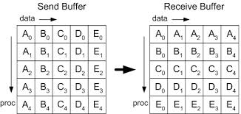
Matrix Transpose
Matrix Transpose => Global Transpose + Local Transpose
=> MPI_Alltoall + Local Transpose

Slide 171
Non-Pipelined Matrix Transpose
// pseudocode
#pragma omp parallel
{
#pragma omp master
MPI_Alltoall()
#pragma omp barrier
for_all_threadprivate_tiles
do_local_transpose(tile);
}

Slide 172
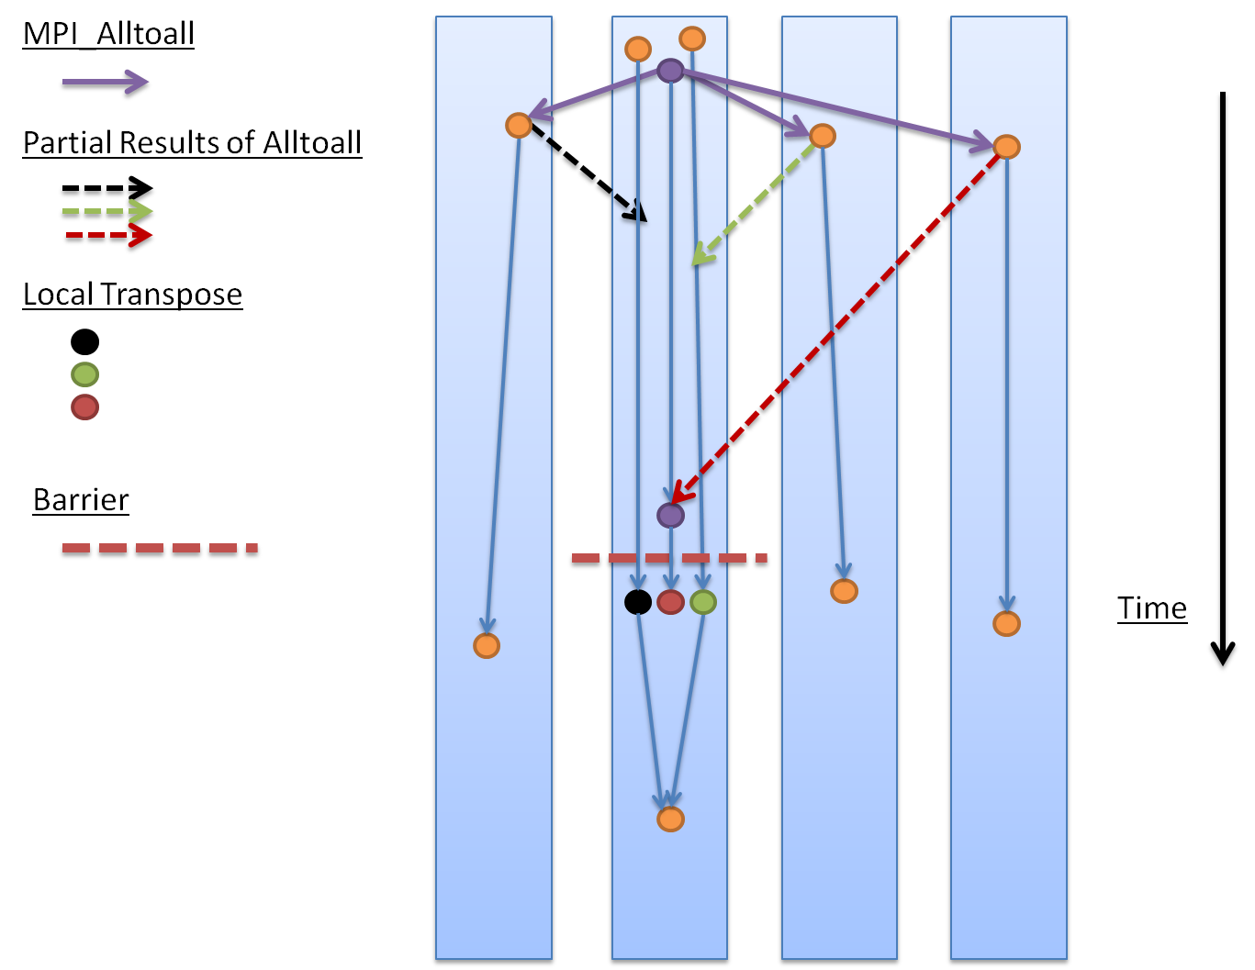
Non-Pipelined Matrix Transpose

Slide 173
Pipelined Matrix Transpose
// pseudocode
#pragma omp parallel
{
#pragma omp master
for_all_other_ranks
gaspi_write_notify(tile)
while (!complete)
{ test_or_die(thread_local tile) // test for notifications for // thread local tiles do_local_transpose(tile)
}
}

Slide 174
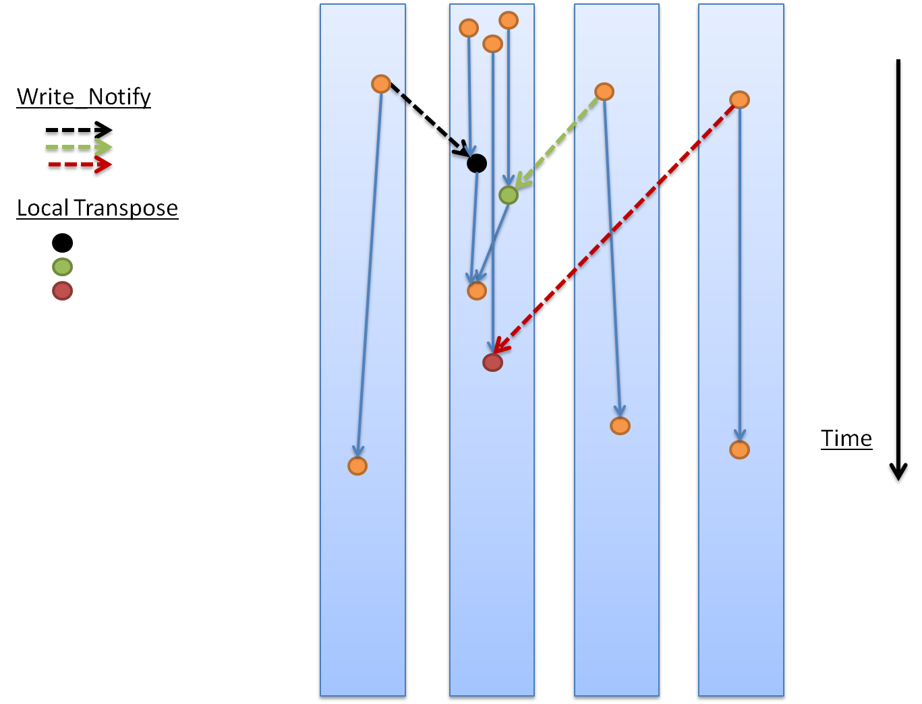
Pipelined Matrix Transpose

Slide 175
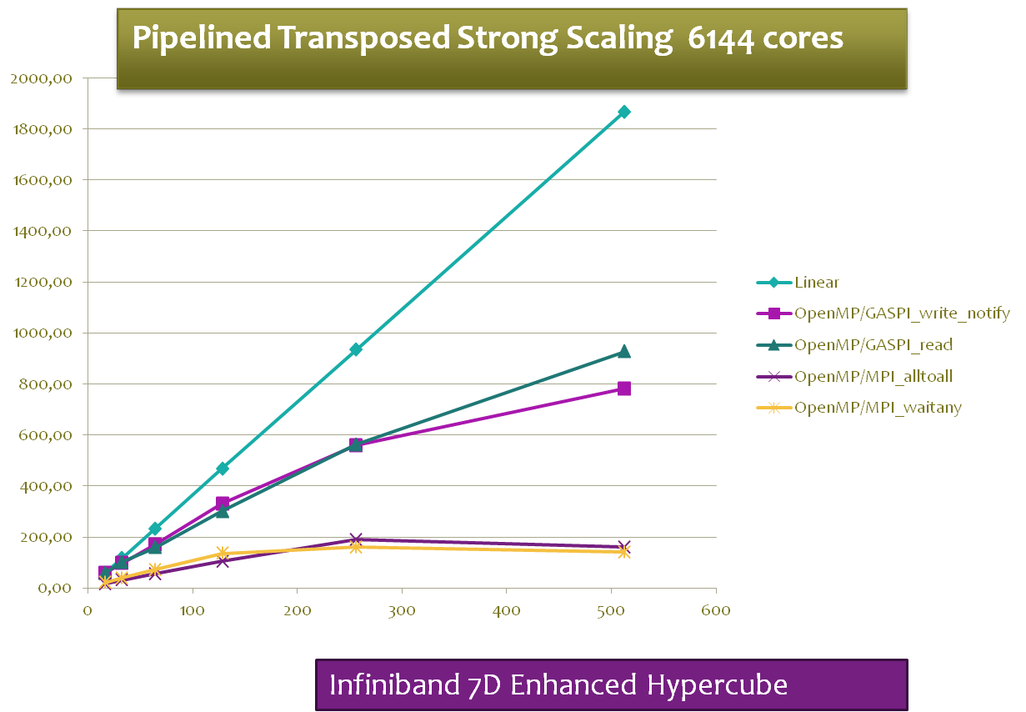
Matrix Transpose

Slide 176
Questions?
Thank you for your attention
www.gaspi.de
www.gpi-site.com

